Slide 1
Health Physics Aspects of the 2022 Planning Guidance for Response to a Nuclear Detonation
68th Annual Meeting of the Health Physics Society
Brooke Buddemeier, Certified Health Physicist
Michael Dillon, Scientist
July 24, 2023

Slide 2
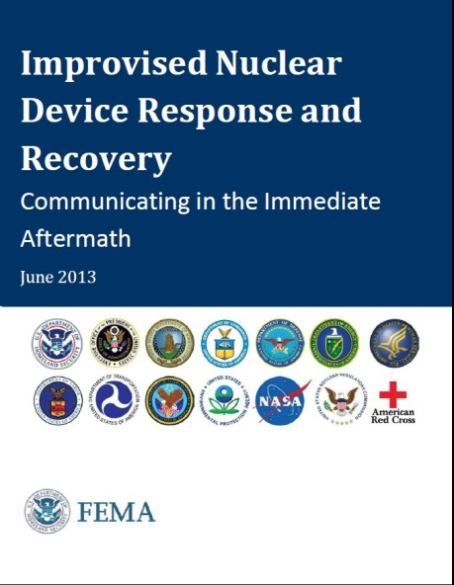
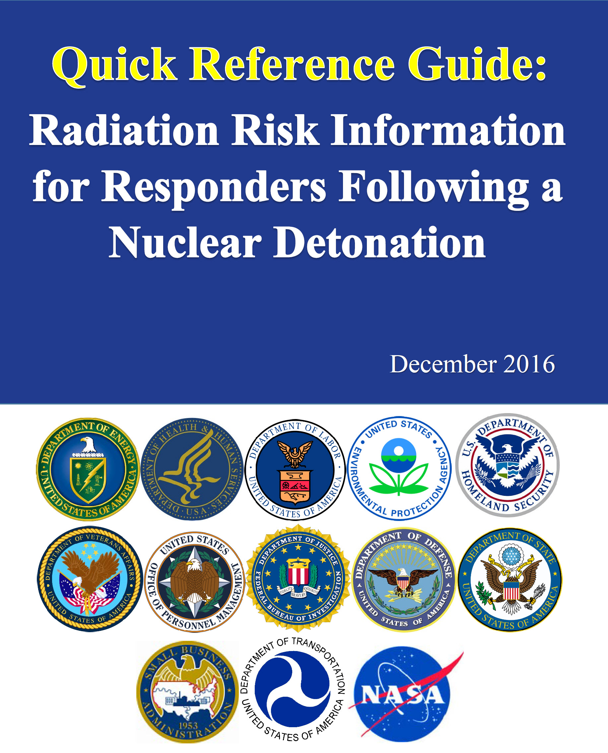
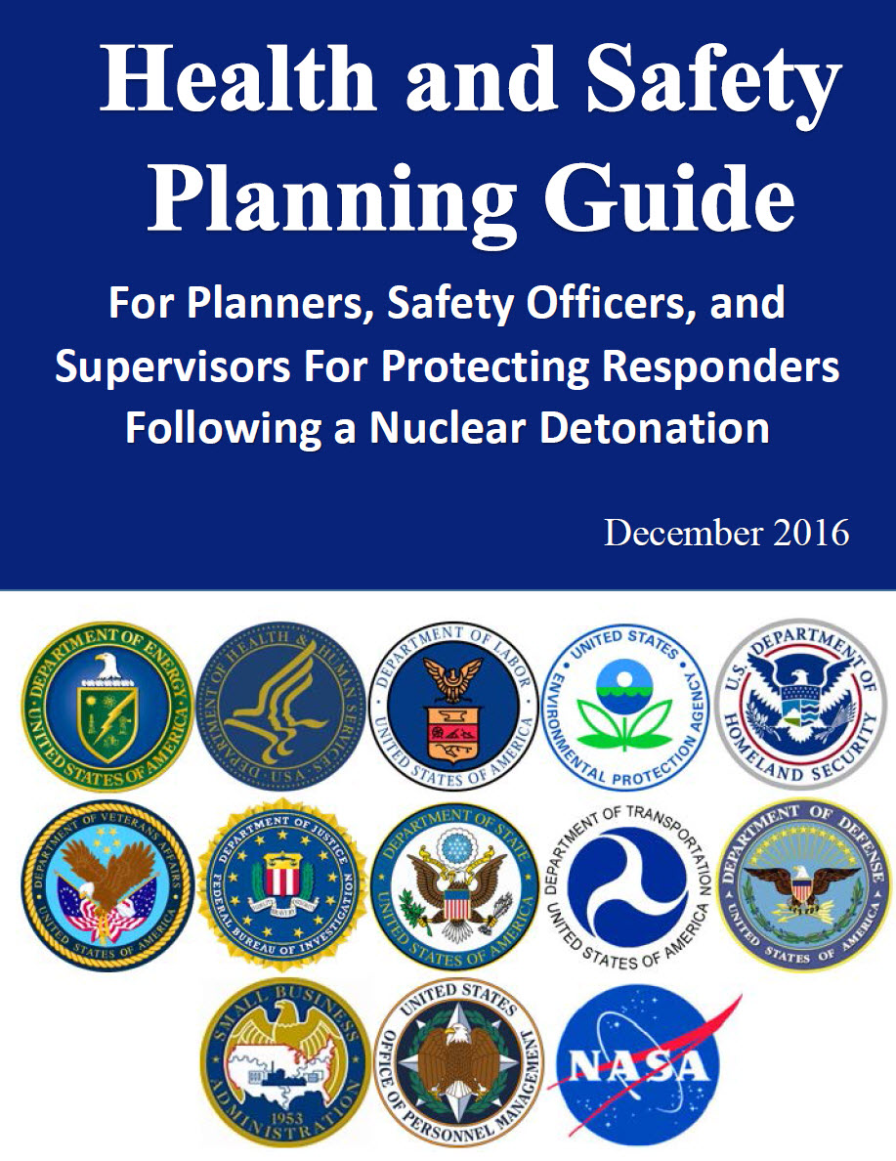
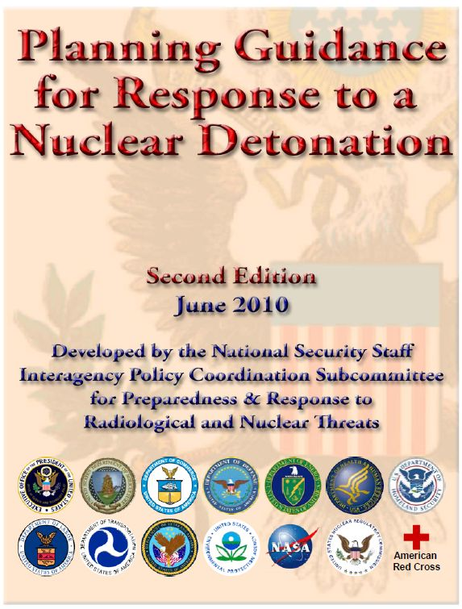
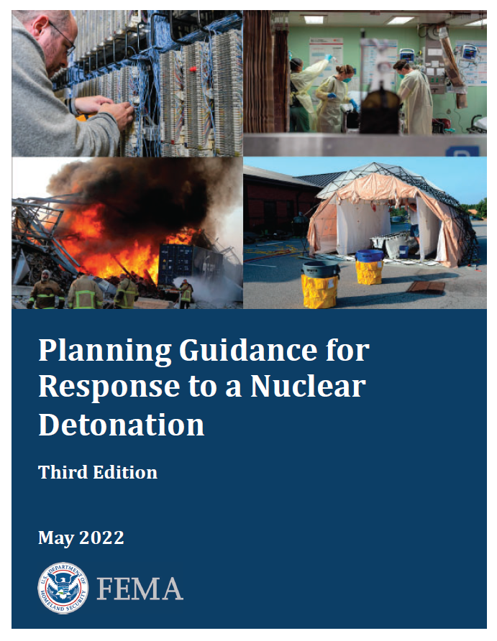
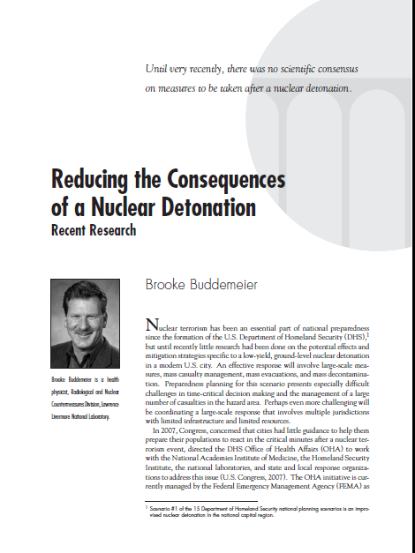
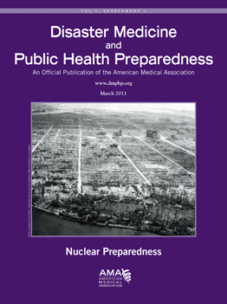
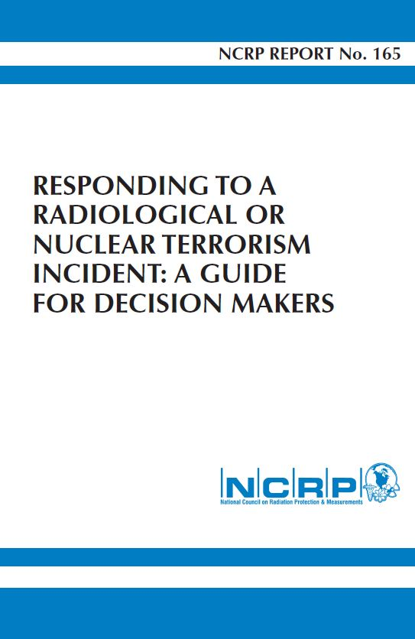
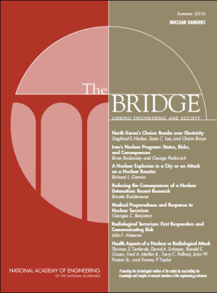
Guidance for Response to a Nuclear Detonation

Slide 3
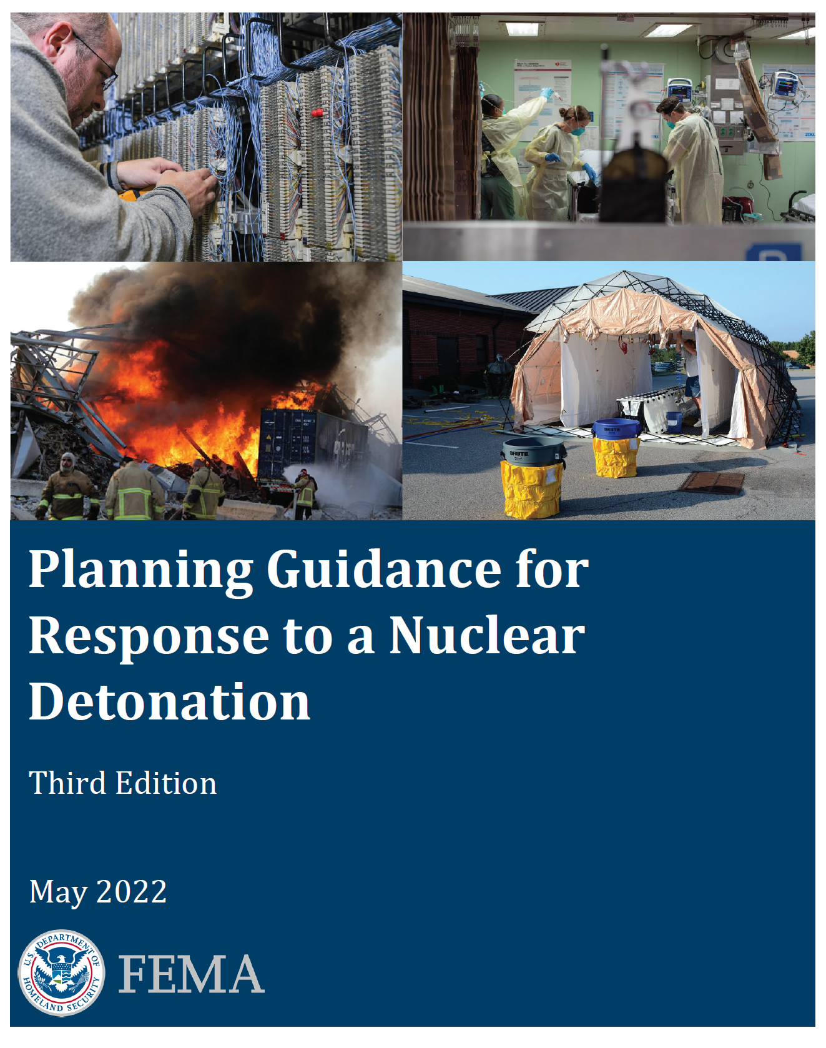
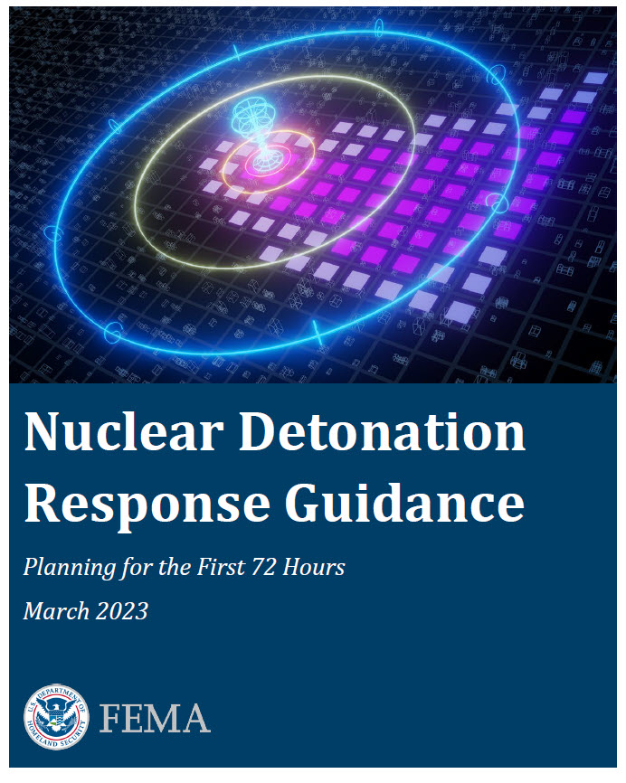
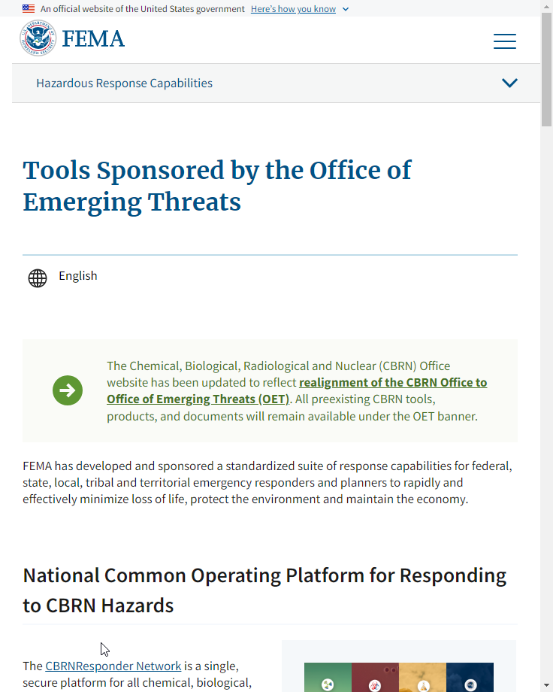
Recent Developments in Response Planning
3rd Edition of Planning Guidance published May 2022
New! Companion Response Guidance published March 2023
Available from FEMA’s new
Office of Emerging Threats Website

Slide 4
Guidance Overview
Primary Audiences
Describes considerations, planning factors, and available resources, to craft a successful response plan for nuclear detonations.
Focuses on the first 24-72 hours after a detonation, when early actions can save many lives, but majority of federal support has yet to arrive.
Planners: Fire response, emergency medical service, HAZMAT response, utility service, public works emergency, transportation, public health, medical provider (e.g., hospitals)
Mass care providers (e.g., American Red Cross)
Local & regional private sector industries capable of supporting immediate response
Other organizations that represent disciplines that conduct emergency response activities.

Slide 5
Planning Guidance Features
Action Items
A suggested activity for the planner to complete.
Coordination Opportunity
An interagency or interorganizational coordination opportunity. Making these connections during planning can simplify coordination during response.
Refer to
References to additional information in separate resources.
What would you do?
A critical thinking exercise or discussion question. These questions highlight unique aspects of nuclear response.
Throughout the document, key opportunities to act, coordinate with key partners, reference external materials, and think critically are highlighted. These opportunities take one of four forms:

Slide 6
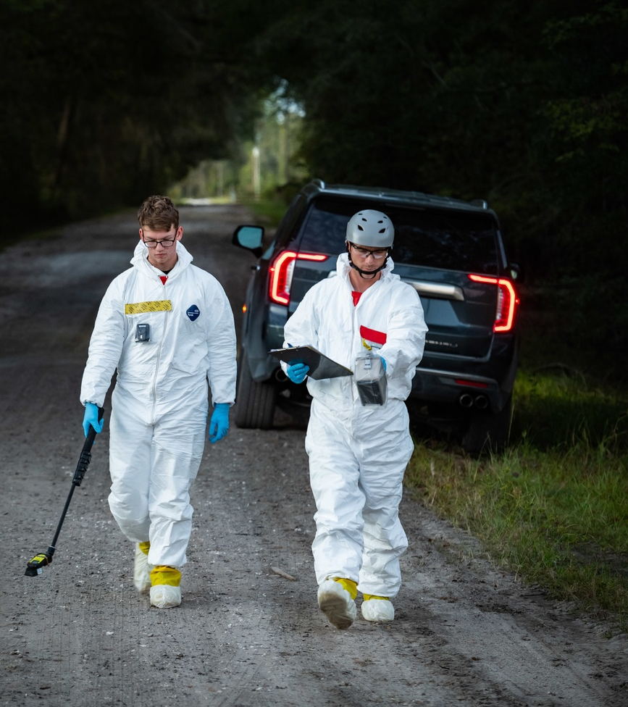
Third Edition Updates
Guidance for a wider range of nuclear detonations, including larger detonations and air bursts
Incorporates more than 10 years of new research, best practices, and response resources
Includes a new chapter on the Integrated Public Alert & Warning System (IPAWS), which enables officials to send warnings and key messages during response
Notes:
Image: https://www.dvidshub.net/image/6915024/20th-cbrne-command-units-train-nuclear-forensics-mission-during-exercise-prominent-hunt
CAMP BLANDING, FL, UNITED STATES
10.26.2021
Courtesy Photo
20th CBRNE Command

Slide 7
Document Structure
Chapters 3-7 are designed to be pulled-out and, when combined with Chapters 1 and 2, form stand-alone guidance documents.
For example, if a planner is only responsible for early medical care, covered by Chapter 4, they would only need Chapters 1, 2, and 4.
Chapter | Writing Lead
1: Nuclear Detonation Impacts | Technical Team (DOE led)
2: A Zoned Approach | Technical Team (DOE led)
3: Shelter & Evacuation | Technical Team (DOE led)
4: Acute Medical Care | HHS/ASPR
5: Population Monitoring | CDC
6: Communications and Public Preparedness | EPA
7: Alerts, Warning, Notifications, and FEMA’s IPAWS | FEMA

Slide 8
Chapter 1: Nuclear Detonation Impacts
Chapter 1
Chapter 1 provides a high-level description of the features that make a nuclear incident unique.
While these subjects are technical, descriptions are tailored for a non-technical audience.
Blast Effects
Prompt Thermal Effects and Fire
Eye Injuries
Initial and Residual Radiation
Height of Burst (HOB) Considerations
Radiation Zones
Radiation Injuries and Fallout Health Impacts
Electromagnetic Pulse (EMP) affects

Slide 9
milliseconds
Intense Flash of Light
Initial Ionizing Radiation
seconds
Thermal pulse
10s of seconds
Blast wave continues out
Electromagnetic Pulse
Blast wave out about a mile
Fireball rises rapidly
minutes
hours
Fallout cloud rises rapidly
Highest levels of fallout deposited
days
Low levels deposit over the globe
Radiation levels drop by 10X
Fallout reaches ground after 10 minutes or more
Some hot spots due to rain

Slide 10
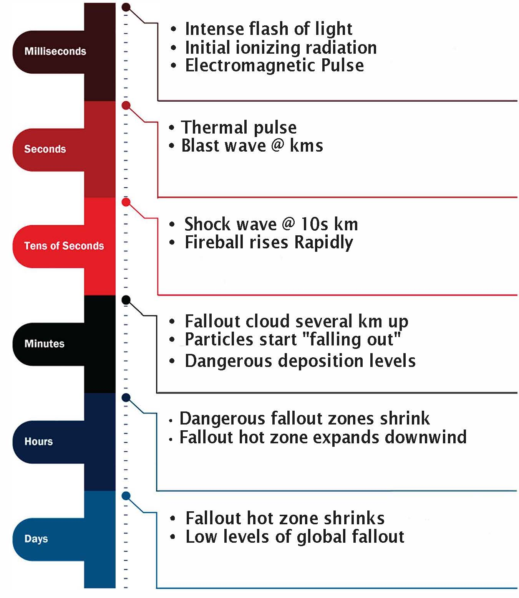

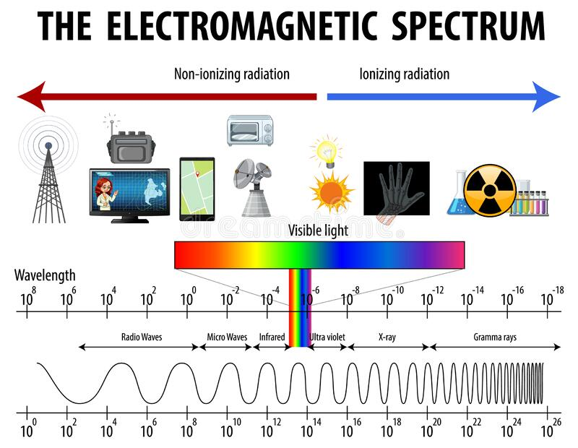

Slide 11
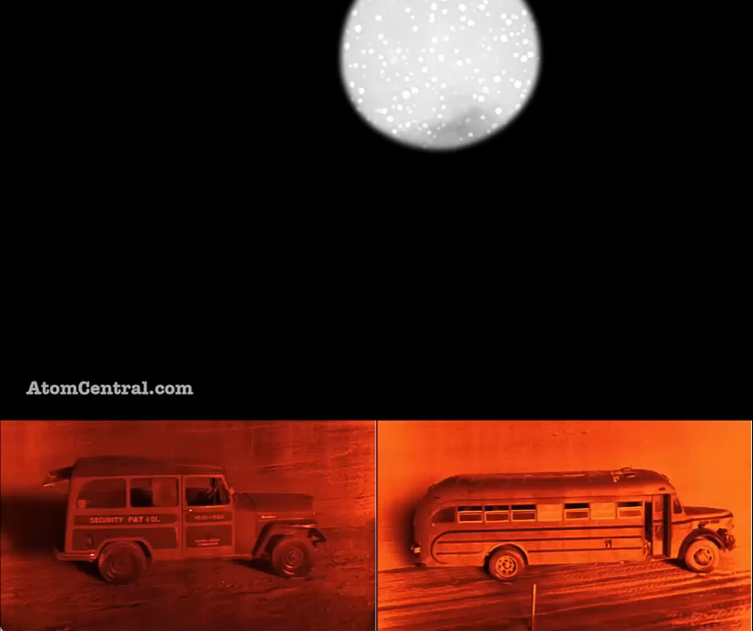
Notes:
Seconds
Thermal pulse
Blast wave @ kms
{Click}
Notice that these vehicles are actually in the Grable shot

Slide 12
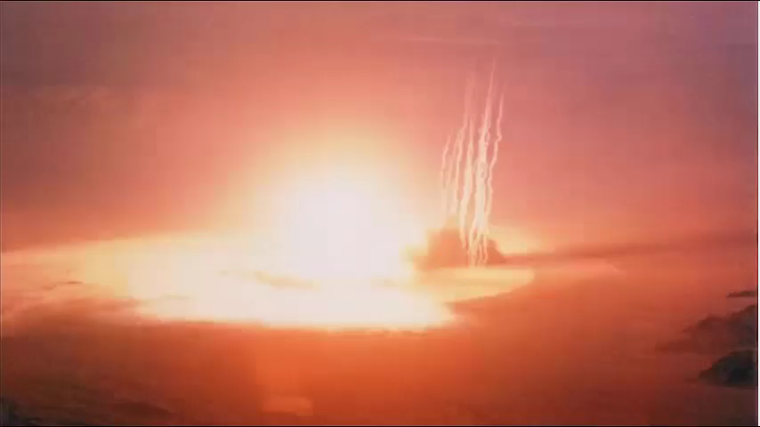
Notes:
Tens of seconds
Shock wave @ 10s km
Fireball rises Rapidly
{click}

Slide 13
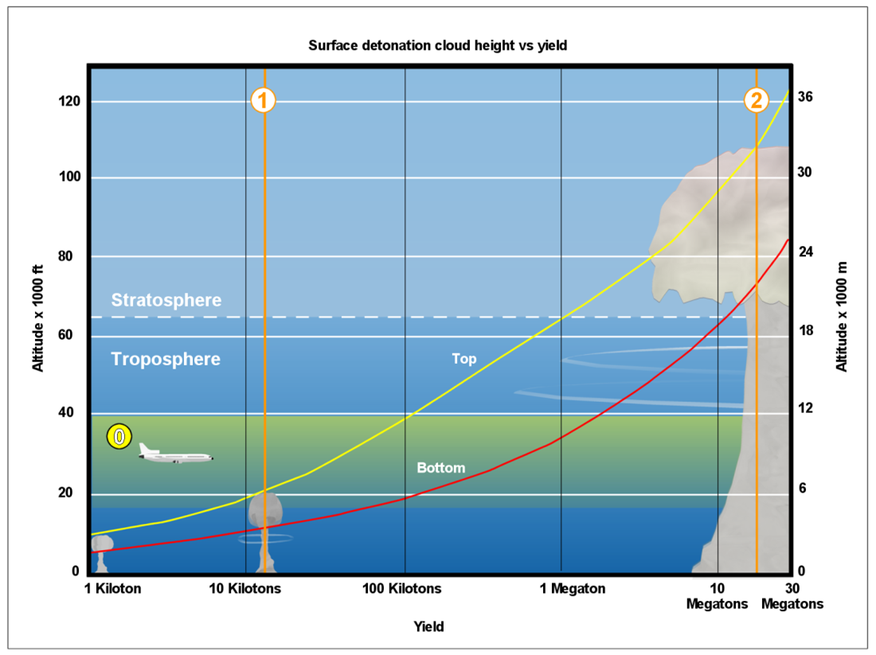
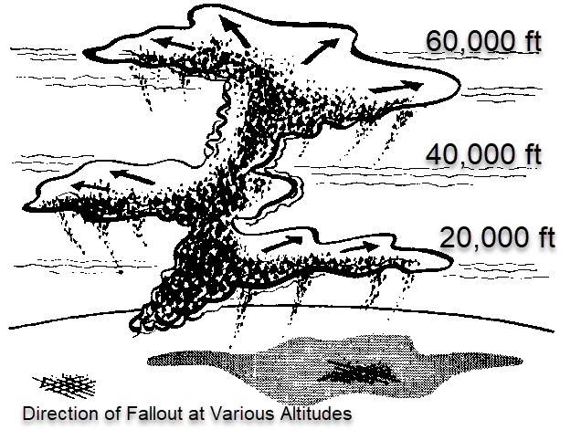
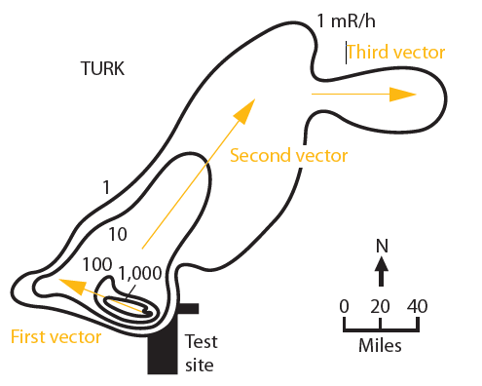
Notes:
Minutes
Fallout cloud several km up
Particles start “falling out” creating potentially dangerous radiation levels on the ground
The height of the cloud depends on the yield
{click} and depending on how high it goes, winds aloft will blow it off in one or more directions.
{click} this can create strange radiation levels on the ground, as you can see by radiation measured on the ground after a test called “Turk”. You can see the 3 distinct wind vectors.

Slide 14
Blast Effects

Slide 15
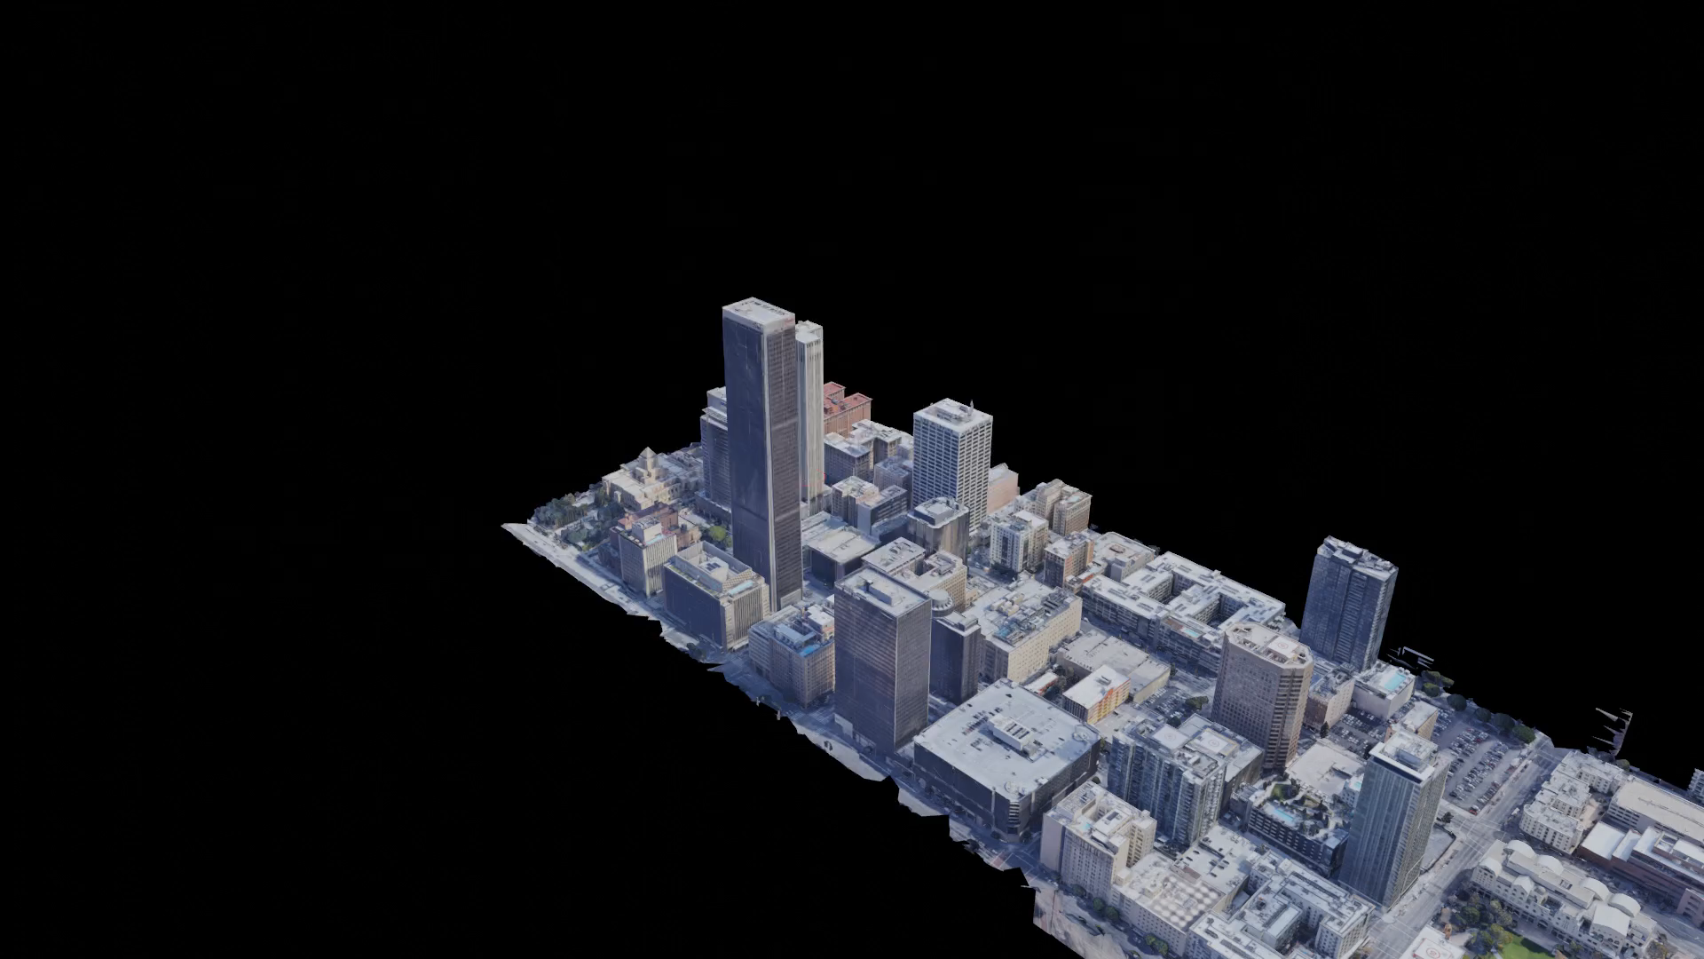

Slide 16
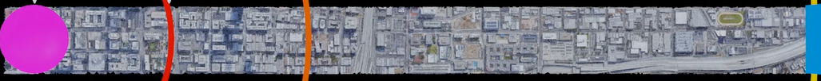
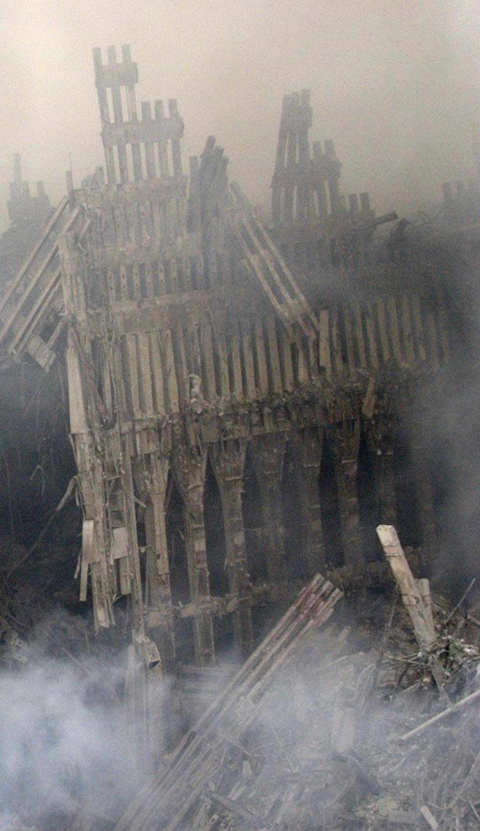
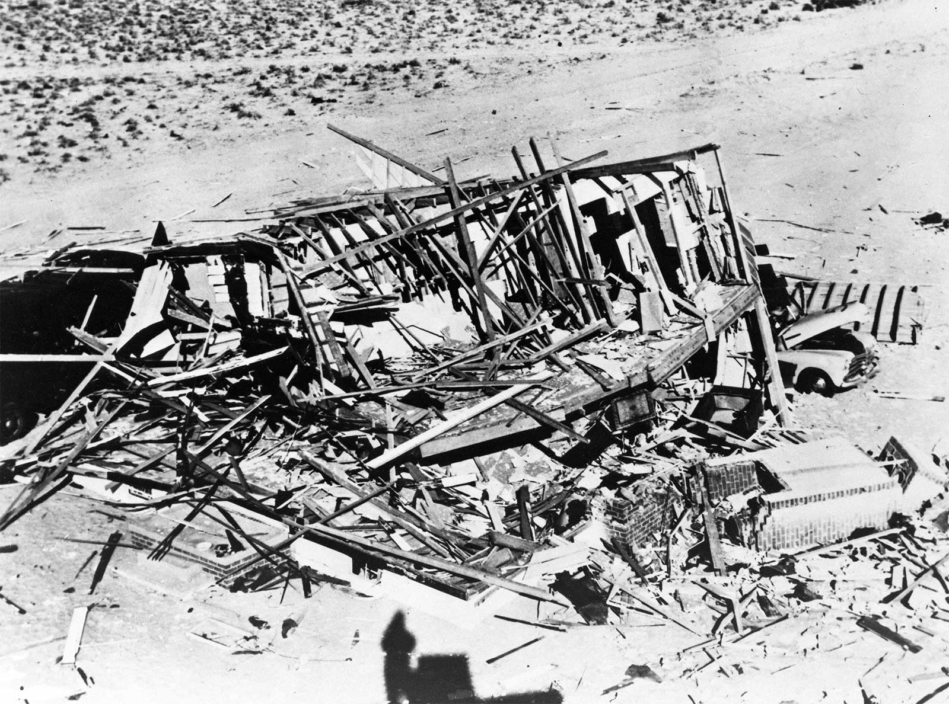
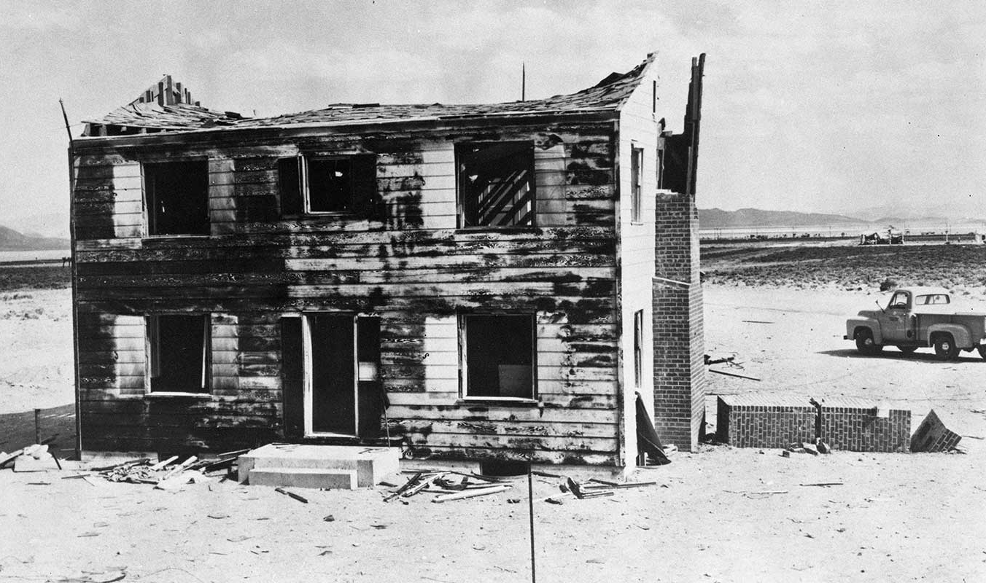
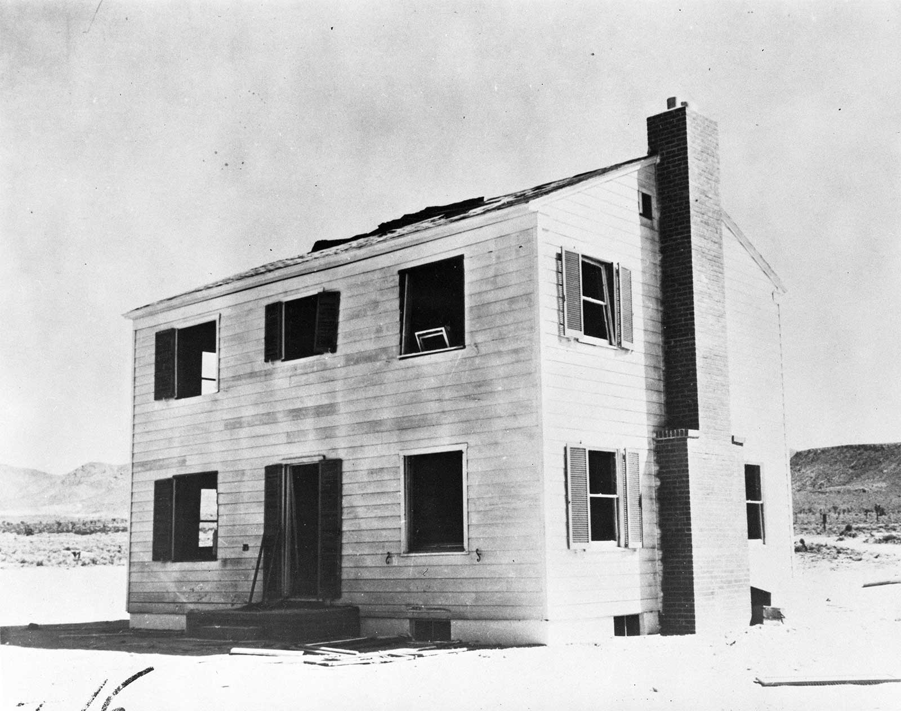
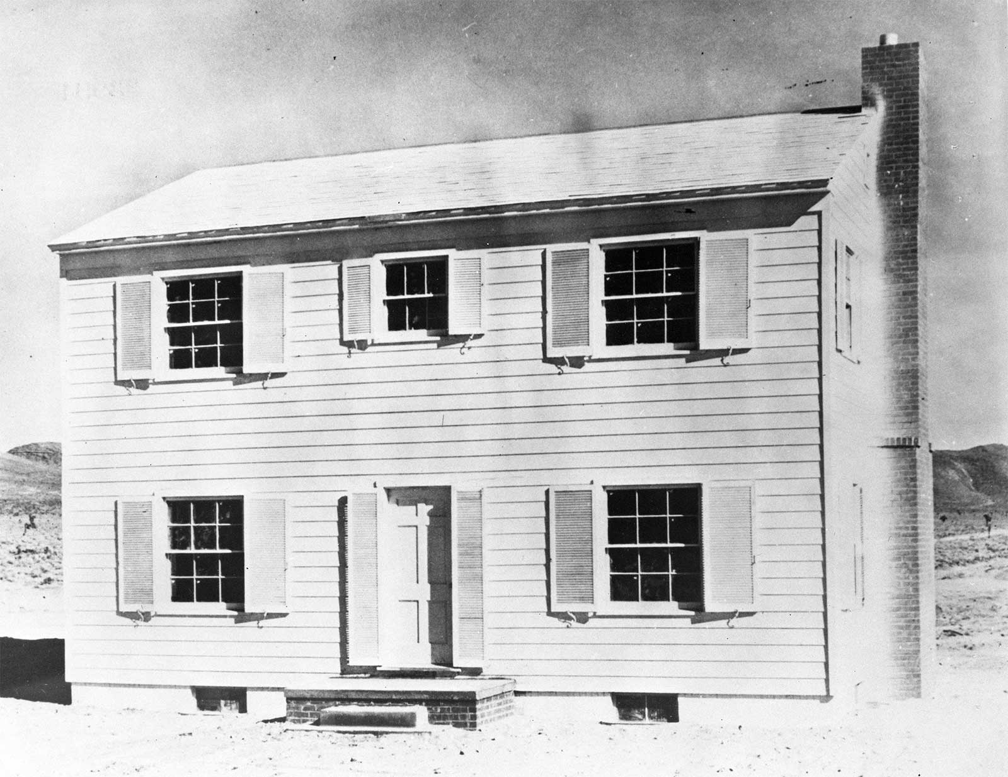
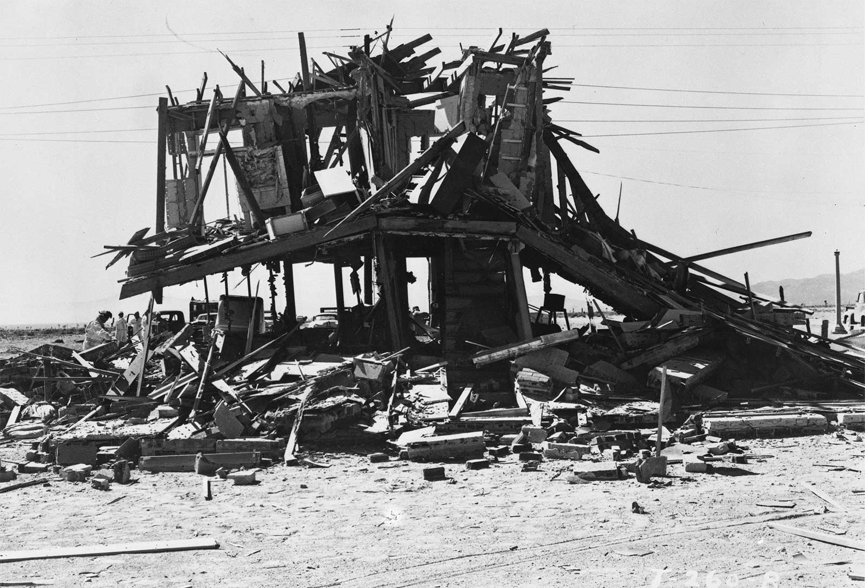
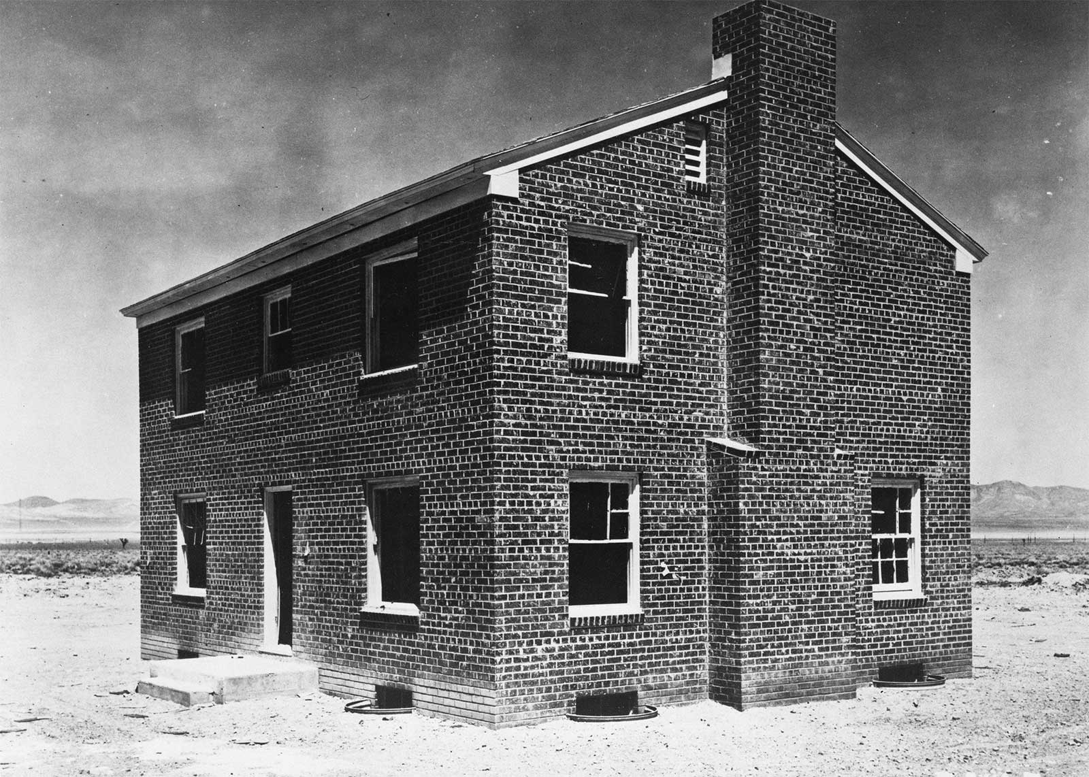
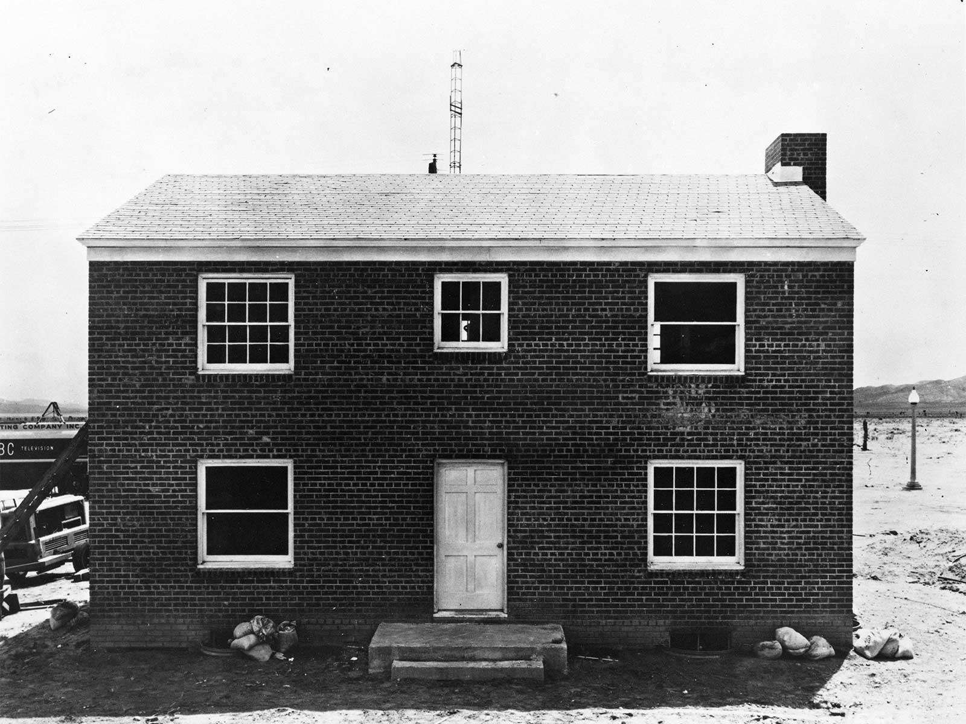
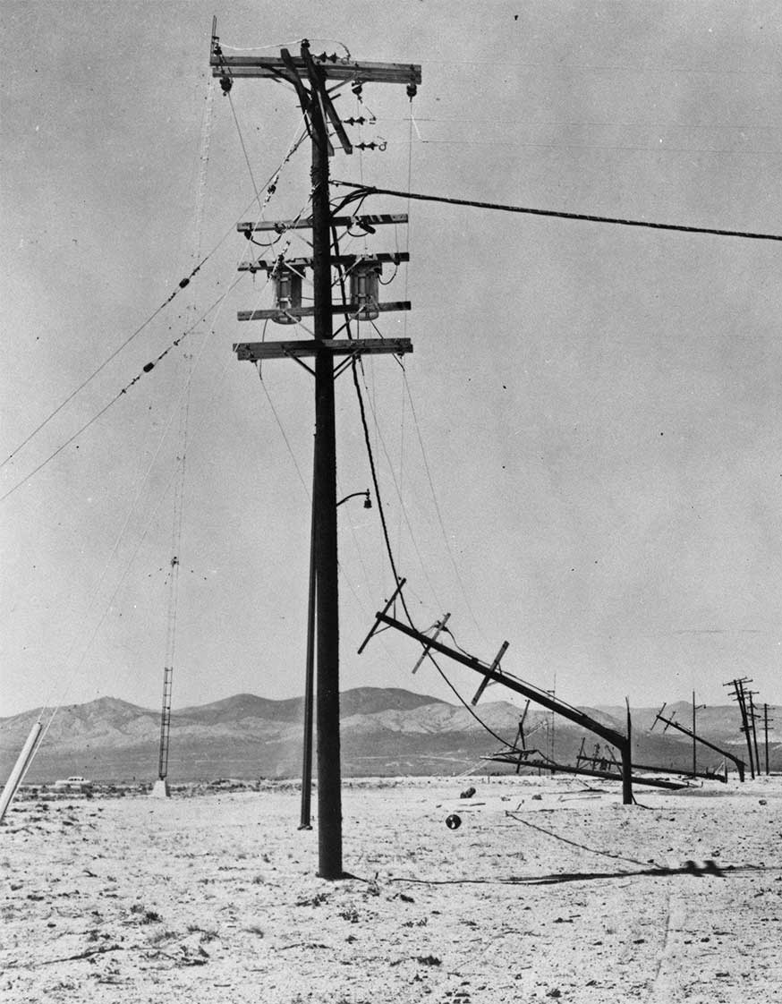
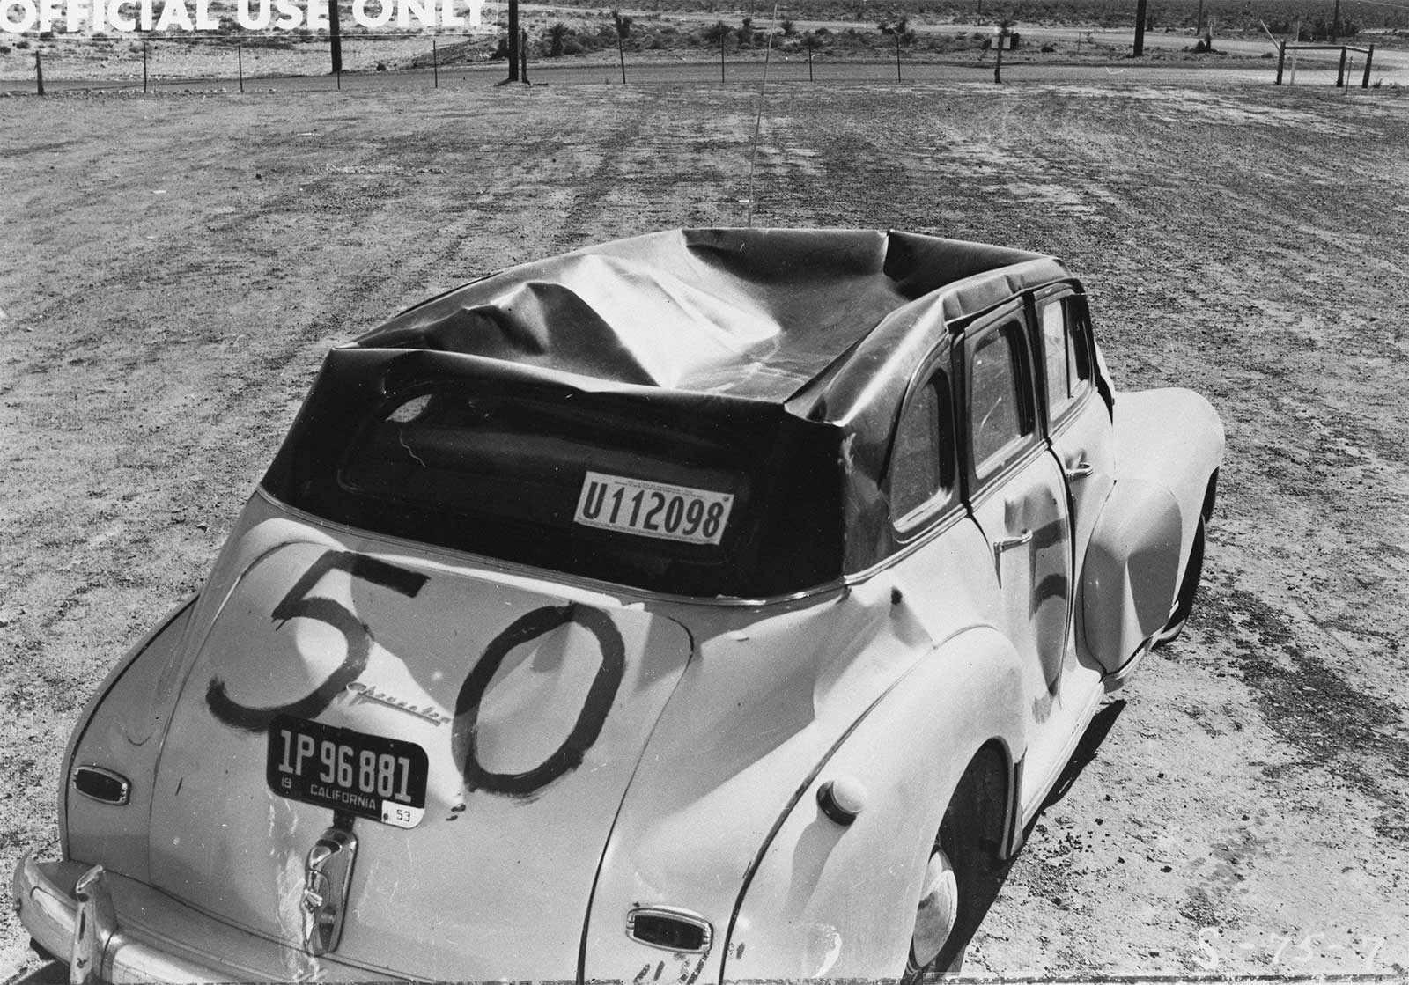
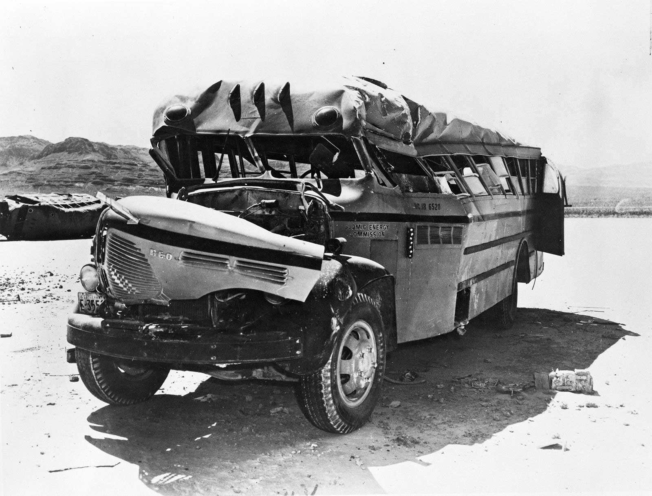
SEVERE
MODERATE
LIGHT
Wood
Brick
Windows and doors blown in
Light Structures Pre-Detonation

Slide 18
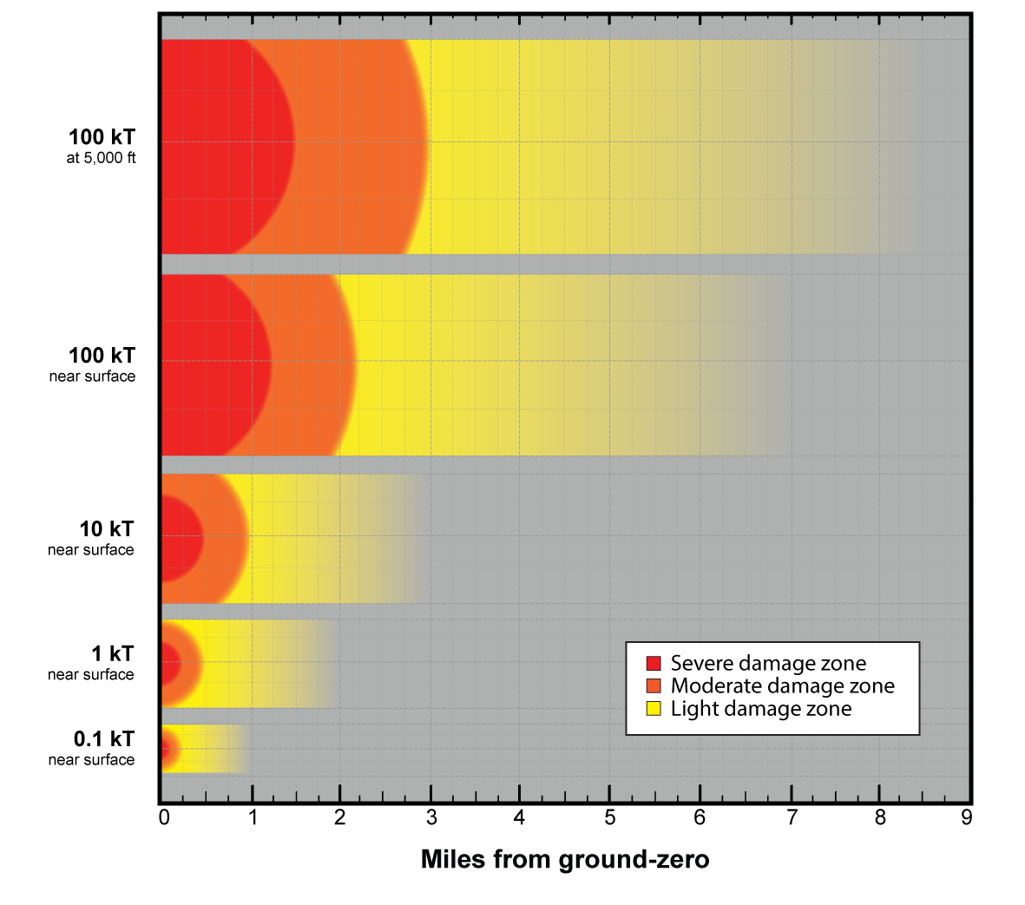
Expanded number of Yields and HOBs
100 kT Air burst, 5000 ft
100 kT Air burst, 1000 ft
100 kT Ground burst
10 kT Ground burst
1.0 kT Ground burst
0.1 kT Ground burst

Slide 19
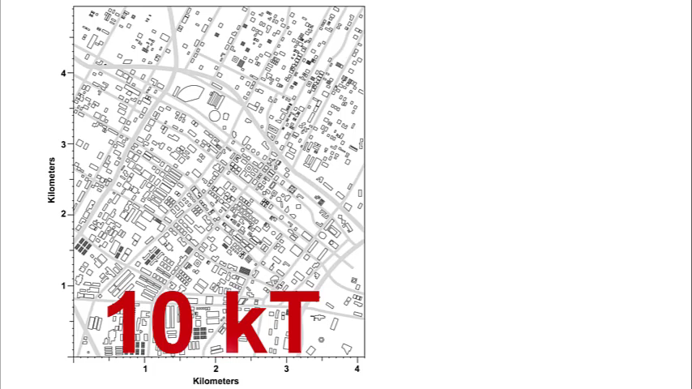
Comparing Ranges
Notes:
The ranges of the severe, moderate, and light damage zones will change with yield.
It is interesting to note that even when you change the yield by a factor of 10, the range of the blast zone only changes by about a factor of 2

Slide 20
Thermal Effects

Slide 21
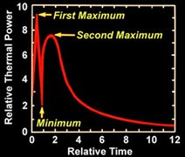
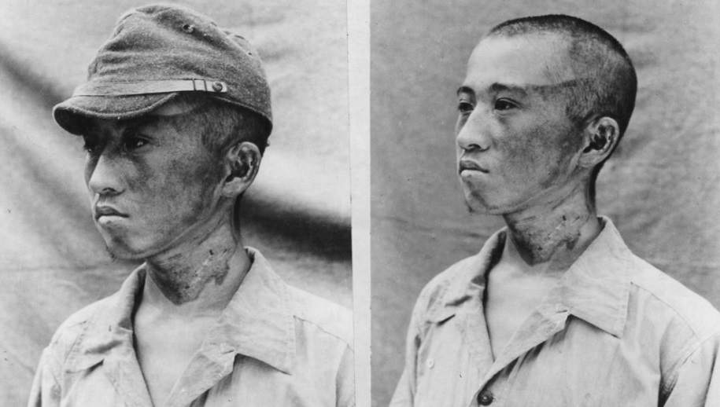
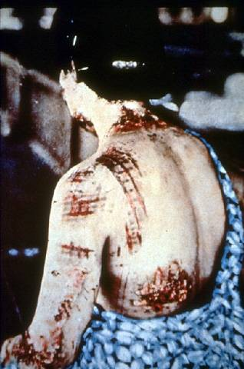
Thermal Impacts
Image Credit: Armed Forces Radiobiology Research Institute
Initial Heat Pulse (1% of energy) occurs within a fraction of a second, too fast to avoid or even blink!
The second, slower heat pulse occurs over several seconds and deposits 99% of the heat energy
This accounted for most of the skin burns in Japan
The pattern is from the dark
colored areas on her kimono
Notes:
Immediately after an explosion, energy is emitted in the form of thermal radiation and, due to the extremely high temperatures, as x rays, which are absorbed within a few feet of air. The energy is then re-emitted and, due to certain phenomena occurring within the fireball, the secondary thermal radiation emission occurs in two pulses.
First pulse. The first pulse lasts only about one tenth of a second. It consists of approximately 1 percent of the total thermal radiation release, and much of the thermal release is in the ultraviolet region. Although ultraviolet radiation can cause skin burns, it appears that this occurs only at ranges at which other thermal radiation effects are more serious. However, although this first pulse may be disregarded as a source of skin burns, it is capable of producing permanent or temporary effects on the eyes, especially if one is looking in the direction of the detonation at the time of the explosion.
Second pulse. The second pulse lasts for several seconds and carries about 99 percent of the total thermal radiation energy. Since the temperature is lower than that in the first pulse, most of the rays reaching the Earth consist of visible and infrared light. This radiation is the main cause of various degrees of skin burns suffered by exposed individuals up to at least 12 miles.
Flash burns. This image of a Nagasaki woman shows flash burns in the pattern of the kimono she was wearing at the time of the blast. The light-colored fabric reflected the thermal radiation whereas the dark-colored fabric absorbed it and became hot, causing contact burns on the skin immediately beneath the fabric. Medical records indicate that, in some cases, dark-colored clothing actually burst into flames and ignited the undergarments, causing flame burns. It should be noted that light-colored clothing does NOT ensure total protection from thermal radiation. Some light-colored fabrics actually transmit enough thermal radiation to allow direct flash burning of the skin.
AFRRI Medical Effect of Ionizing Radiation (MEIR) training.

Slide 22
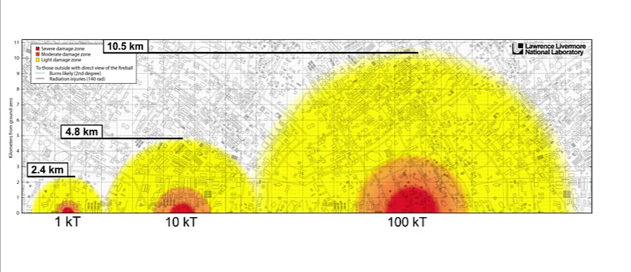
Prompt thermal range not proportional to blast effects
At higher yields, prompt thermal effects can occur farther than blast injuries
At higher yields, the range of thermal injuries extend into the light damage zone
24
Notes:
remove

Slide 23
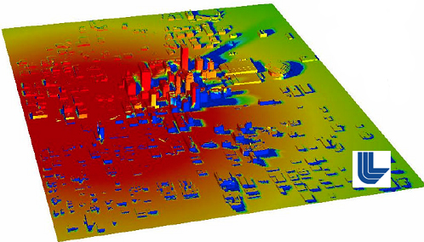
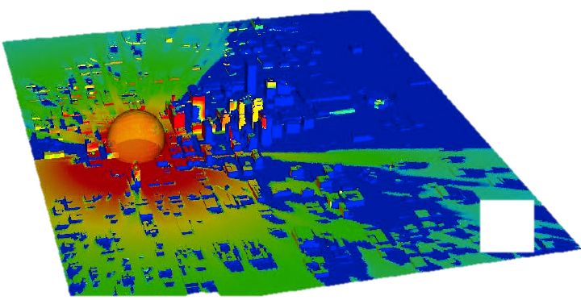
Shadowing of Thermal Effects
Detonation at 300 m
Detonation at the surface
R. E. Marrs, W. C. Moss, B. Whitlock, Thermal Radiation from Nuclear Detonations in Urban Environments, Lawrence Livermore National Laboratory, June 7, 2007. UCRL-TR-231593
Notes:
Evaluating Line of Sight
The protection afforded by the urban environment can greatly reduce the number of previously calculated burns that have been cited in many previous studies.
The image on the top right indicates the thermal effect for a 10kt detonated 300m over the OK City bombing site. You can see how the “circles of effect” are a pretty good representation of injury.
Click – the lower image is the SAME YIELD and SAME LOCATION, but now detonated on the ground so you can see the level of protection afforded by the urban environment. The blue and green areas on the map are areas of little or no thermal burns.
On the left is the image of the radiation exposure coming off of a nuclear device 1 meter over a concrete slab,
Click - when the DC urban environment is added in, you can see how the radiation is also mitigated and, unless you are looking at the detonation down a line of site roadway, the DC environment can reduce the exposure by a factor of 10 or more.

Slide 24
Fires
Chapter 1
Fires can seriously complicate protective actions because they may warrant evacuations when fallout is present.
Air burst nuclear detonations increase the amount of nuclear induced fires within a few miles of point of detonation.
Large urban fires can be a significant threat to survivors in damage zones and evacuation may be required to save lives.
Air bursts and yields greater than 10 kT thermal pulse can ignite fires and cause lethal burns to those in line-of-sight to the fireball.

Slide 25
Ionizing Radiation Effects

Slide 26
Nuclear Detonation: Ionizing Radiation
Radiation has serious effects on response and is the defining feature of nuclear incidents.
Chapter 1
Prompt (Initial) Radiation
Residual Radiation
Occurs in the first minute of a nuclear detonation.
Contributes to casualties within a couple kilometers of ground zero.
Intensity decreases with distance from ground zero.
Some initial radiation risks can be mitigated by protective measures taken before the detonation.
Radiation given off after the first minute.
Produced by fission products and activated material that continue to give off radiation.
Most dangerous in the first few hours; decays over time.
Can mix with dirt lofted by the explosion to create fallout locally and downwind.
Federal Emergency Management Agency
22

Slide 27
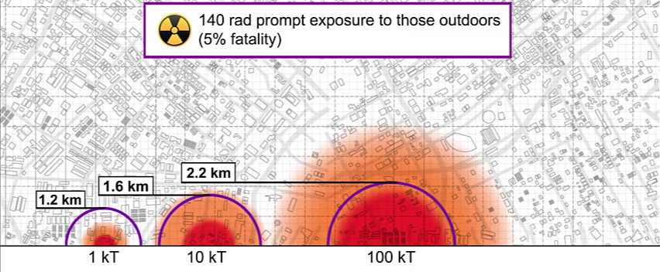
Prompt radiation range not proportional to blast effects
At lower yields, prompt radiation effects to people can occur farther than blast injuries
24

Slide 28
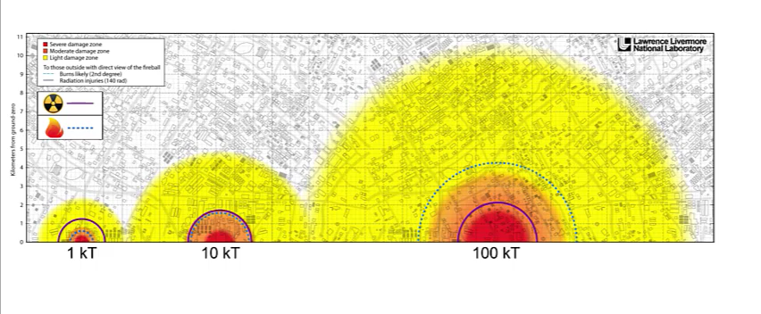
Range of Prompt Thermal and Radiation
24

Slide 29
Residual Radiation

Slide 30
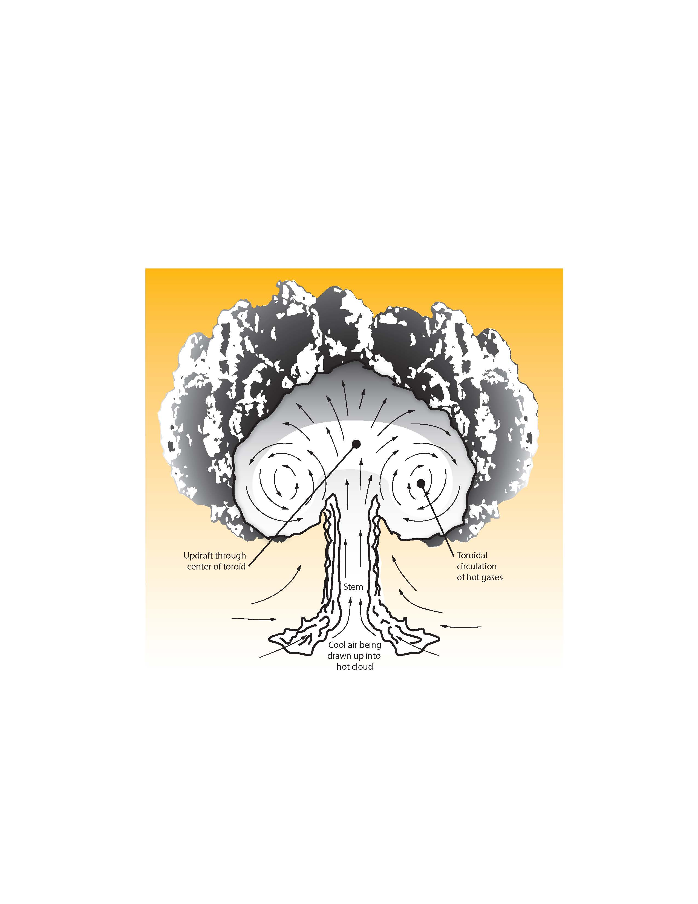
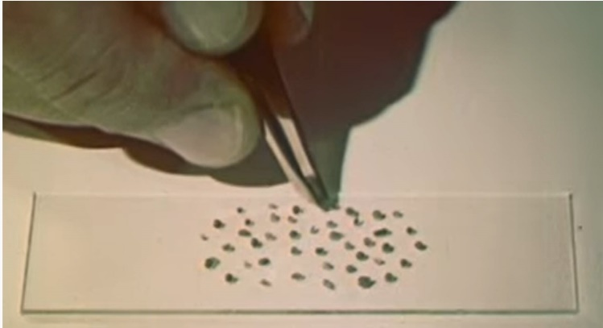
Fallout
Chapter 1
Fallout is generated when dust and debris created by the explosion are combined with radioactive material and subsequently dispersed downwind of the point of detonation.
Fallout can occur early (w/in 24 hrs of detonation) or weeks later.
Weather patterns, including wind and rain, can contribute to fallout dispersal.
Fallout contamination decays rapidly, shrinking dangerous radiation zones within days of release.
Nuclear detonations produce large amounts of fallout, because of radioactive debris in the column of smoke.
Fallout depends on the height of burst above the ground.
Near surface detonations may sweep up thousands of tons of dirt/debris that mix with radioactive products in the cloud, creating radioactive fallout particles.
Notes:
Instructor Notes:
Radioactive Fallout
Fallout occurs when particles contaminated with radioactive material fall back to the earth.
Fallout is sometimes applied in a collective sense to radioactively contaminated particulate matter itself.
Fallout can occur as the result of any R/N incident, but it is a hallmark of nuclear detonations.
Depending on weather patterns, radiation levels may be elevated far from ground zero. Fallout can also be brought to the ground by precipitation such as rain or snow, producing a local radiation hot spot wherever it falls. Emergency managers and responders must consider this in terms of resource allocation and public messaging.
Fallout contamination decays rapidly however RDD fallout does not decay as quickly as IND or NPP fallout.
Nuclear Detonations
After the explosion, radionuclides attach to airborne particles of varying sizes, ranging from particles smaller than the naked eye can see, to pebble sized particles that can fall out downwind at various distances, hence the name “fallout.” In the case of a near-surface detonation, fallout will be concentrated near the detonation and will, in general, decrease with increasing downwind distance.
A strong updraft is caused by the rising fireball, that can suck up dirt and debris into the radioactive cloud for a near surface detonation. The nuclear cloud and the descending fallout material are pushed by the winds in a direction that may not be evident from ground-level wind observations, therefore, ground-level winds alone should never be used to predict the path of fallout deposition.
If detonations occur far from the earth’s surface (in the air above the target, as opposed to near the ground) the risk of fallout decreases, but the severity of nuclear induced fires increases within a few miles of the detonation.

Slide 31
Introducing more Height of Burst Issues

Slide 32
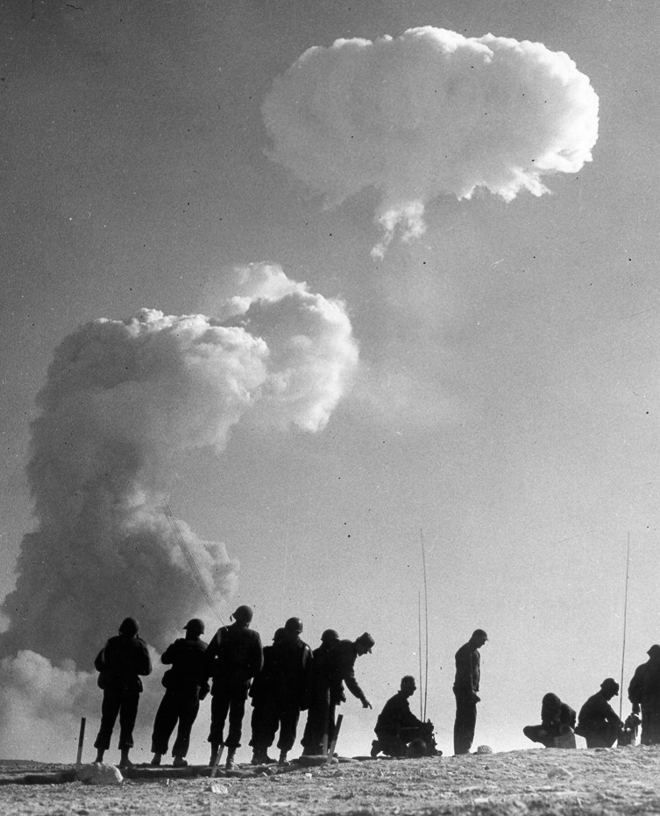
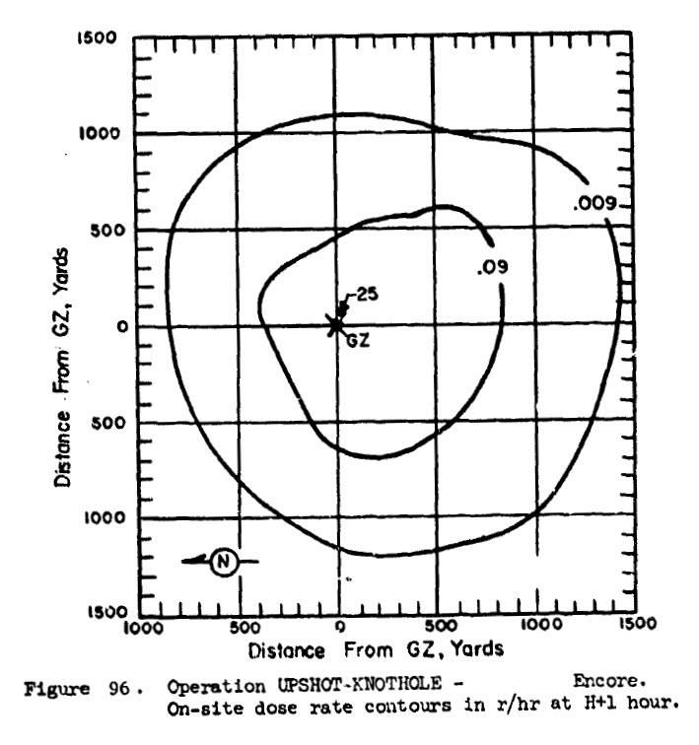
Upshot-Knothole Encore
27 kT, Airburst 2423’, 8 May 1953
Good representative for:
  100 kT @ 5,000’
No appreciable fallout
  10 R/h (from activation) limited to small area directly under detonation.
  0.01 R/h (from activation) limited to < 1,500 yards from GZ
  Detectable (but much less than 0.01 R/h) fallout measured across the U.S.
H+1 data from DASA-1251
Minimal Mixing Example
Photo courtesy of National Nuclear Security Administration / Nevada Field Office.
Photo Library under number UK-53-105.

Slide 33
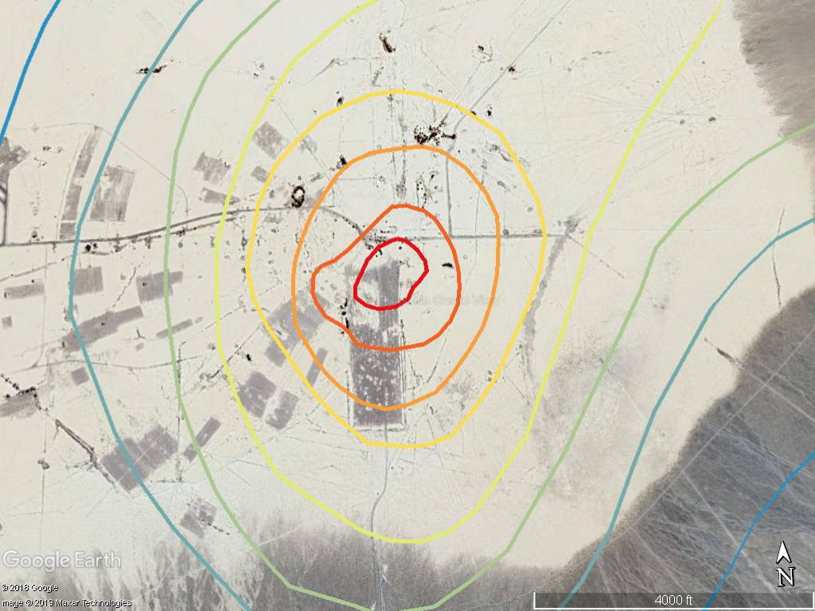

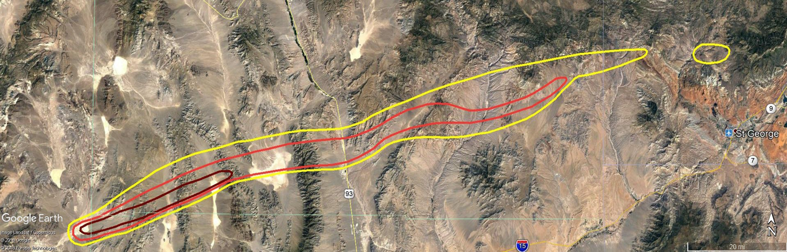
Priscilla “Partial Mixing” Detonation
5 R/h
1 R/h
10 R/h
Plumbbob Priscilla Test
37kT detonated at 700 ft
(fallout free height is 760 ft for 37kT)
50 R/h
0.5 R/h
500
R/h
0.1 R/h
10 R/h limited to
within 750 yards
H+1 data from DASA-1251
Partial Mixing Example
0.01 R/h
0.02 R/h
0.01 R/h over 130 miles at Max Extent (~ 7 hours)
0.1 R/h
PLUMBBOB Priscilla
Converted from DASA-1251
H+1 data decay corrected to H+7 hrs)
Notes:
Archival CollectionU.S. Department of Energy Photograph Collection on the Nevada Test Site (PH-00282)
TitleMushroom cloud from the "Priscilla" nuclear test: photographic print
Description"Priscilla" was a 37 kiloton balloon test fired June 24, 1957 at the Nevada Test Site.

Slide 34
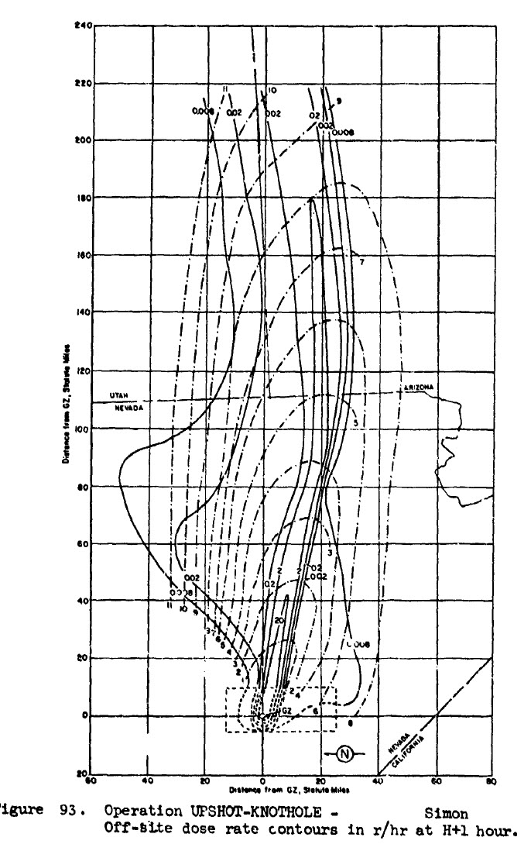

H+1 data from DASA-1251
Simon “Significant Mixing” Detonation
Upshot-Knothole Simon
43 kT, Tower 300’, 25 Apr 1953
0.01 R/h goes out > 220 miles. At 10 hours
0.01 R/h contours exceed offsite monitoring
Dangerous Radiation Zone (10 R/h) reaches max extent ~ 1.75 hrs and goes past 40 miles.
H+1 data decay corrected to H+1.75
Significant Mixing Example
Nevada Site Office Photo Library under number UK-53-102
0.1 R/h
Notes:
The 20 R/h (H+1) contour reaches max extent at ~ 1.75hr
20 R/h (H+1) would be ~ 10 R/h (H+1.75 hr).

Slide 35

Upshot-Knothole Simon; 43 kT, 300’ HOB, 25 Apr 1953
Significant Mixing Example
Date | Fallout Location and Type
25 Apr | Significant dry deposition in NV, UT, and AZ
26 Apr | Significant dry deposition in UT, NM, and TX Extreme rainout event in Albany, NY (Highest deposition of Upshot-Knothole tests outside the Nevada Test Site)
27 Apr | Dry deposition over most of Central U.S. Rainout events occurred in Northeast U.S.

Slide 36




Variations Based on Height of Burst
For elevated detonations, Fallout related zones may be reduced or absent.
No hazardous local fallout
Reduced fallout intensity and area (no DRZ)

Slide 37
Technical Team Summary of Fallout Considerations
The additional scenarios introduce new phenomenology concerns
  Higher yields add longer range thermal pulse concerns
  Elevated detonations may increase some prompt effects, but reduce fallout concerns
  Activation becomes the primary local residual radiation concern for elevated detonations
  Less local fallout from detonations in the partial mixing zone (e.g., the 100 kT @ 1,000’), but it can be more challenging to characterize.
Rainout hot spots can be generated well downwind of the detonation
  Can be present even with detonations in the minimal mixing regime (e.g., 100 kT @ 5,000’)
  Can occur at long ranges (though the longer the range, the lower the activity deposited)
  If rainout occurs locally (within a few hundred miles) it can potentially generate dangerous radiation levels (> 10 R/h), especially for significant or partial mixing events.
Low hazard (< 10 mR/h), but easily detectable, radiation levels will likely be found for hundreds (or more) of miles. This may generate significant public concern.
Notes:
The partial mixing zone (e.g., the 100 kT @ 1,000’ scenario) can be more challenging to characterize as the fallout composition will have different radionuclide composition and decay rates that traditionally assumed.

Slide 38

Electromagnetic Pulses (EMPs)
Chapter 1
The initial nuclear radiation from nuclear detonations generates an electromagnetic pulse.
Although not a direct physical hazard, EMPs can disrupt or damage some electronic equipment, including power grid components.
  EMPs can cause disruptive power surges on power lines within tens miles of the detonation, inducing cascading disruptions further from the detonation site.
Electronic equipment and infrastructure damage can seriously impact response operations.
Notes:
Instructor Notes:
An EMP is a product of nuclear detonation and does not occur during other radiological events.
Damage to consumer equipment that is attached to commercial power can extend to about 5-10 miles from the detonation location, depending on specific characteristics of the electric power system impacted.
Potential EMP impacts include vehicles stalling and the destruction or disruption of communications equipment (cell towers, etc.), computer equipment, water and electrical system control components, and other electronic systems.
In some cases, resetting electronic equipment may restore its function following an EMP.
There are no direct health effects of EMP exposure, but there are numerous secondary effects derived from failing electronic systems such as vehicle crashes, medical equipment failure, and loss of power leading to heat or cold injuries.
Outside of EMPs, R/N incidents may impact the electric grid and Energy Community Lifeline in other ways, such as damaging physical infrastructure. Grid recovery will be one of FEMA’s greatest concerns and which will be complicated and have a long lead time.

Slide 39


Slide 40
Chapter 1: Summary of Technical Team Findings
Scenarios introduce new considerations
  The current Severe, Moderate, and Light damage zone construct is still valid as the yield and HOB changes. However, some outdoor thermal injuries can extend into the into the light damage zone for higher yield / air bursts.
  Fallout mixing regimes and neutron activation adds some complexity.
  Potential for rain events causing isolated dangerous hot spots (> 10 R/h).
  Fire and thermal effect concerns are more extensive with higher yields and HOB.

Slide 41
Chapter 2: A Zoned Approach
Chapter 2
An adaptable, zoned approach to prioritize response activities and coordinate collective allocation of scarce resources among jurisdictions, states, and regional organizations.
Provides flexibility to responders who must process an overwhelming amount of incident information and rapidly generate prioritized response actions.
5 Hazard Zones
  3 Blast Damage Zones
  2 Radiation Zones
Emergency Worker Safety
Critical Infrastructure Decontamination
Radioactive Waste Management

Slide 42
Formally Dangerous Fallout Zone
Notes:
One of the most important areas of IND response planning and preparedness is the identification of Key Zones by the Federal Planning Guidance and the National Council of Radiation Detecton and Measurements.
The 5 zones are depicted in this graphic and are:
The Severe Damage Zone
The Moderate Damage Zone
The Light Damage Zone
The Dangerous Fallout Zone
The Hot Zone
The most important thing about these zone is that they are defined by observables in the field, NOT by models! In this way a responder can determine what zone he or she is in by what they see around them and what their radiation instruments are telling them.
Zone Review
Severe Damage Zone appears
The Severe Damage Zone extends to about half a mile from the blast site. This zone will see severe structure damage from the initial blast wave, and most likely fatal injuries from the blast, thermal pulse, and prompt radiation.
Moderate Damage Zone appears
From ½ a mile to 1 mile from the blast site of a 10KT is the moderate damage zone, This is the area with a large number of significant injuries and represents the area with the most life-saving potential.
This area has significant structural damage and fires. Victims in this area have the greatest chance of avoiding deadly radiation doses by seeking shelter immediately.

Slide 43
Zoned Approach to Response
  Defining zones can be a useful approach to planning:
  Identify priority zones
  Prioritize actions within each zone
  Identify responder protection in each zone
  Determining where to locate staging areas
“The goal of a zoned approach to nuclear detonation response is to save lives, while managing risks to emergency response worker life and health.”
2nd Ed. Planning Guidance for Response to a Nuclear Detonation
Notes:
43
Click –Defining Zones appears
A well-thought out response plan can help maximize life-saving potential, and minimize the risks to emergency responders. When setting up a response plan, it is important to:
Click -Identify Priority Zones: Priority zones should be identified by deciding which zones have the best chance for saving lives without putting responders into conditions that are too dangerous for them. Look for areas that victims might have found shelter in, and help victims nearest the outside of structures first.
Click -Prioritize Actions within Each Zone: Determine the actions, in order, which will maximize the response. Determine which structures to enter first, estimate out how much time can be spent in each area before radiation doses get too high, and determine evacuation routes.
Click -Identify Responder Protection in Each Zone: Ensure that responders are safe in each zone they enter. If responders decide they can enter a zone safely, ensure that adequate safety measures are taken based on the level of radiation and other possible hazards (debris, smoke, etc.) in the area. Use personal protective equipment (PPE) like dosimeters and respirators to ensure safety.
Click -Determine Where to Locate Staging Areas: There may be multiple staging areas depending on the size of the blast. Staging areas may be set up along each zone to treat victims within those zones. A main staging area should also be set up in an area without any radiation, if possible. This staging area should be used
Read Quote

Slide 44


Key Fallout Considerations
Fallout Decays Rapidly (releasing more than half of its energy in the first hour)
Primary hazard from fallout is exposure to penetrating radiation from the particles
Fallout is not a significant inhalation hazard
Dangerous levels of fallout is visible
as it falls
Being outside or in a car will not protect you
The radiation penetrates through
windows and walls, but exposure
decreases with distance and
intervening materials (shielding).

Slide 45

Zones are based on Observables, not models.
Zone | Observables
LDZ | Extensive window/exterior damage Structures intact, but most windows broken Some (mostly) minor injuries due to glass & debris Fires possible, especially near MDZ
MDZ | Significant Damage and Injuries Large number of collapsed & unstable structures Many fatalities and severely injured. Rubble and fires, potential for firestorm
SDZ | Complete destruction of most buildings The few survivors, only in large buildings or underground. High radiation hazard from activation and fallout.
DRZ | Dangerous radiation levels outdoors > 10 R/h outdoor dose rates Radiation hazard primarily first few hours, will overlap MDZ & LDZ Outdoor radiation hazard, recedes over first day
Hot Zone | Elevated radiation levels > 0.01 R/h outdoor dose rates Potentially large area (100s of miles), will overlap MDZ & LDZ Protective public to reduce reduce long term cancer concern. May take hours for fallout to arrive in outlaying areas, recedes after a day
Zones are based on observables and measurable radiation levels.
Information should be reported back to a centralized location to help build a Common Operational Picture

Slide 46



Fire Stations Radio Local Conditions
Structures intact, but most windows broken
Minor injuries due to glass & debris
Few fires
Large number of collapsed & unstable structures
Many fatalities and severely injured.
Rubble and fires
 | LDZ
 | MDZ

Slide 47





Emergency Management Builds Zone Map
Radiation Readings at 1hr
> 10 R/h
0.01 - 10 R/h
< 0.01 R/h
Early Priority: Obtain approximate radiation levels in the area.
  Identification of high hazard zones (reading greater than 10 R/h) is a priority, but
  Reporting safe areas (reading less than 0.01 R/h) is also important for safe evacuation routes and response staging areas.
  Share / Coordinate information across the region to inform Shelter & Evacuations
Notes:
Determining the Dangerous Fallout Zone
Knowing where the highest radiation levels are is crucial to responder safety. Knowing how to determine the DFZ can help responders know which areas to avoid, as well as which parts of the damage zones are safe to enter for response activities.
Click –Fire station locations appear
These dots represent the fire stations in Los Angeles.
Click –Blast zones appear
Many of the fire stations are within the three blast zones that will be affected by the detonation. Responders at these fire stations can help determine where the DFZ is located.
Click –Dose rates appear
By taking radiation readings, a pattern can be determined. As you can see, even though some are closer to blast zones than others, there are all levels of dose rates. Those with dose rates of 10R/hr and higher are within the DFZ.
Click –DFZ lines appear
After determining the pattern of fire stations with 10R/hr and higher ratings, perimeters for the DFZ are established.
Click –DFZ and blast zones appear
This data, along with weather conditions for the day, help pinpoint the directions that the DFZ will spread.

Slide 48




Moderate Damage Zone Priorities
Significant injuries
High Priority

Slide 49

Hot Zone Priorities

Slide 50



Hot Zone Priorities
Messaging Priority
Messaging Priority

Slide 51

Personal Protective Equipment (PPE)
SCBAs, Respirators, Firefighter “turnouts”, Level A, B, or C HAZMAT suits do not protect against the primary hazard - the penetrating gamma radiation given off by fallout.
        Radiation / dose monitoring primary protection
        Inhalation & ingestion is a secondary concern compared to the external exposure.
        Turnouts and anti-contamination clothing can help ease decontamination after entries, but not required for time-critical, life saving activities.
“Reducing the time spent in high dose-rate areas is the greatest protective measure. Bulky isolation suits and elaborate respiratory protection methods may actually increase exposure as they reduce the speed, the ability to communicate, and worker efficiency.”
~Key Response Planning Factors for the Aftermath of Nuclear Terrorism
Notes:
Responder PPE
The best way to prevent radiation exposure is to avoid it. The only way to receive a lower dose of radiation is to avoid the DFZ. HAZMAT suits, respirators and SCBAs do not offer any protection against the primary hazard of radiation – penetrating gamma rays.
Inhalation and ingestion are secondary concerns. Attempting to wear hazard suits or respirators will only slow down a responder and cause them to spend more time in dangerous areas. These suits have proven to reduce speed, the ability to communicate and cut down on worker efficiency.
When working with dangerous levels of radiation, the best course of action is to simply stay out of the DFZ until radiation levels drop below 10R/hr and it is safe to enter and begin response efforts.
This is why Radiation and Dose monitoring equipment are so important, as they can help you identify when you are in a hazardous radiation environment.

Slide 52
Chapter 3: Shelter & Evacuation
Chapter 3
Sheltering is one of the most, if not the most, important protective action.
Timely Messaging
Adequate Shelter
Sheltering Guidance
Situational Awareness
Evacuation Guidance
Self-Evacuation
Contamination Concerns
Sheltering and evacuation can reduce the number of people exposed to life-threatening situations, such as high levels of radiation, medical emergencies, and fires.

Slide 53

Chapter 3
Adequate Shelter
Radiation: The best radiation protection is underground (e.g., basements, subway tunnels, underground parking garages) or in the center of large, heavy buildings.
Blast: Underground areas or the center of building that have heavy construction (concrete, brick, or cement) to mitigate blast effects.
Dust & Smoke: Close windows and doors to minimize the amount of outdoor air being drawn into the building. Make sure to maintain enough ventilation to ensure adequate indoor air quality.
Notes:
An adequate shelter is a location that is heavy enough construction (e.g., concrete, brick, or cement) to mitigate blast effects (if sheltering prior to detonation) and reduce radiation exposure from fallout by a factor of 10 or more.
RADIATION: The best radiation protection is underground (e.g., basements, subway tunnels, underground parking garages) or in the center of large, heavy buildings.
Most commercial buildings contain some adequate shelter.
Smaller single-family homes, particularly wood/steel frame houses, do not usually provide adequate protection above ground, though is still far better than being outside. Thicker-walled masonry buildings and residential basements generally provide adequate protection.
Cars do not provide adequate shelter.
BLAST: Underground areas or the center of building that have heavy construction (concrete, brick, or cement) to mitigate blast effects. Protection from blast effects is not the primary purpose of sheltering, as populations may not have time to seek shelter from these effects but is important to consider ensuring shelters are structurally sound. If adequately warned of a possible detonation, seek shelter in the most structurally sound location available
DUST AND SMOKE: Close windows and doors to minimize the amount of outdoor air being drawn into the building. Make sure to maintain enough ventilation to ensure adequate indoor air quality.
Shelters such as houses with basements, large multi-story structures, and parking garages or tunnels can generally reduce doses from fallout by a factor of 10 or more.
Vehicles and single-story wood frame houses without basements provide limited shielding and should not be considered adequate shelter.
Graphic: Buildings provide protective fallout shielding – Numbers represent a building protection factor. A building protection factor of 10 indicates that a person in that area would receive 1/10th of the dose of a person in the open. A building protection factor of 200 indicates that a person in that area would receive 1/200th of the dose of a person out in the open.

Slide 54

When planning evacuations, planners must consider
Chapter 3
Responder and evacuee risks, including radiation exposure along the evacuation route
The threat of fires or hazardous material exposure in the area
Transportation resources (e.g., vehicles, public transit, rail, air, water)
Ease of access and egress (including infrastructure damage to roads, bridges, and tunnels)
Evacuation support resources
Impact of self-evacuating populations
Notes:
Sheltering is implicitly short term
Initial sheltering should be followed by staged, facilitated evacuation for those in fallout-impacted areas.
Optimal shelter stay times can range from a few hours to several days and depends both on the local fallout dose rate and the radiation dose incurred during evacuation.
Where possible, individuals should stay in an adequate shelter for the first 24 hours following detonation to prevent exposure to high levels of radiation.
Evacuations should occur only after appropriate paths have been identified and cleared.
Fire concerns should be closely monitored as rapidly evolving fires may warrant emergency evacuation of potentially impacted areas.
Attempting to evacuate excessively large areas at a single time unnecessarily diverts resources from other response needs. Be aware that many people may choose to self-evacuate.
Image: https://www.thereporter.com/2021/08/30/south-lake-tahoe-evacuations-many-sierra-at-tahoe-ski-resort-buildings-still-standing/
Gridlock on Highway 50 eastbound through South Lake Tahoe, Calif., as the town goes under an evacuation order because of the Caldor Fire, Monday, Aug. 30, 2021. (Karl Mondon/Bay Area News Group)

Slide 55
Chapter 4: Acute Medical Care
Chapter 4
The large number of casualties caused by a nuclear detonation will overwhelm local medical systems.
Injuries: Identification, Triage, and Treatment
  Mechanical trauma
  Thermal burn injuries
  Radiation injuries
  Hematopoietic acute radiation syndrome
  Microbial Infections
  Psychosocial and behavioral healthcare
Initial Mass Casualty Triage in Scarce Resource Environments
  Resource scarcity
  Triage
  Medical Countermeasures (MCMs) in the Strategic National Stockpile (SNS)
Radiation Triage, Treatment, and Transportation (RTR) system
Fatality Management
Notes:
Chapter 4 Appendices include
LD50/60
Subsyndromes of ARS
Burn Injuries
Triage
Guidance Resources for Healthcare Providers, Responders, and Planners
Response Support Teams and Planning Resources
Resources for Medical Examiners and Coroners (ME/Cs) and Fatality Management Planning
Appendix 4.3, Figure 41: The layers of skin tissue, with burn-depth for different burns shown (derived D'Arpa et al., 2017)

Slide 56

Chapter 5: Population Monitoring
Chapter 5
Population monitoring: assessing the impact population’s exposure to radiation or contamination through interview and screening with equipment (if available).
Contamination considerations
Screening for contamination
  External
  Internal
  Self-decontamination
Community Reception Centers and Mass Care Shelter Operations
Long-Term Registry and Follow-up
Notes:
Chapter 5 Appendices include
Impacted Populations
Strategies for Screening and Decontaminating People
Strategies for Screening and Decontaminating Service Animals and Pets
Handling Contaminated Vehicles
Resources to Support Contamination Screening Activities
Available Tools for Tracking and Monitoring People
Chapter 5, Figure 30: Example of ad hoc, CRCs and mass care shelter screening locations relative to the incident site.

Slide 57
Chapter 6: Communications and Public Preparedness
Chapter 6
Communications strategies for all nuclear detonation scenarios have the same baseline criteria – immediate, clear, and instructive messages for public health and safety are the priority.
Pre-Incident Communications Planning
  Community Preparedness and Awareness
  Audience Assessment and Preparation
  Interjurisdictional Relationships and MOUs
Immediate Response Communications Priorities
  Safety Instruction Dissemination
  Communications Infrastructure
  Worldwide Media Interest
  Intraorganizational Communication Challenges
  Loss of Life Messaging

Slide 58
Pre-Incident Communications Planning
Chapter 6
Without pre-incident knowledge, key messaging, and preparedness steps, people will likely follow the instinct to run from danger, potentially exposing themselves to fatal doses of radiation that could be avoided by sheltering.
Plan and execute nuclear detonation preparedness education campaigns related to other hazards and harness teachable moments.
Determine your audience and develop tailored messaging/communications.
Develop interjurisdictional relationships and Memorandums of Understanding (MOUs)
Notes:
Pre-incident preparedness is a difficult task regardless of hazard. In addition, with a public that associates nuclear detonations with certain death, the sense of futility, fatalism, and hopelessness severely impacts their desire and ability to absorb information and follow instructions.
Gather support for preparedness campaigns from a coalition of decision-makers and other public health agencies in your community. Identify the best spokespeople to assist with broad preparedness campaigns.
Leverage all-hazards messaging in preparedness outreach-- because of resistance to open discussions about nuclear detonations, emergency management agencies and public affairs staff must integrate nuclear detonation messaging into all-hazards messaging.
In teachable moments, something has happened to remind the public about nuclear detonations, but there is no threat. During teachable moments, heightened awareness of a threat or emergency increases the public’s desire for knowledge about how to protect themselves and their loved ones. Teachable moments are an opportunity for emergency planners and public information/affairs staff–in these moments, the public is more willing to listen to preparedness messages without being frightened by the messages themselves.
Depending on you audience, they may use different means of communication (radio vs phones vs etc.) and have different priorities. For instance, if your audience includes parents, the outreach strategy must communicate the necessity of staying indoors, even when children are not with their parents. Preparedness messaging must incorporate school and daycare safety plans and explain the dangers of parents attempting to pick up their children.
When faced with this type of resource-straining incident, officials and responders must know who to rely on for assistance. Cultivating and maintaining assistance relationships with neighboring towns, cities, and counties, as well as state and federal response organizations, is critical to ensure this aid.

Slide 59
Chapter 7: Alerts, Warnings, Notifications (AWNs), and FEMA’s IPAWS
Chapter 7
Importance of AWNs
Public Alerting Authorities
Public Alert and Warning (A&W) Systems for Mass Notification
Integrated IPAWS Components
Public AWN in Operational Planning
Community Lifelines and ESFs
AWN Planning Factors for Low-Altitude Nuclear Detonation
Planning for Post-Detonation AWNs
In the immediate aftermath of a nuclear detonation, instantaneous alerts, warnings, and notifications (AWNs) are necessary to tell people in the affected area how to avoid death and injury from radiation. Development of significantly improved AWN capabilities, such as FEMA’s IPAWS, is helping to mitigate hazards and lessen the impact of all disasters, including nuclear detonation.
Notes:
Chapter 7, Figure 35: A “smart kiosk” displaying WEAs.

Slide 60

FEMA’s Integrated Public Alert and Warning System (IPAWS)
Chapter 7
The IPAWS is a national A&W infrastructure available for use by FSLTT public alerting authorities to send emergency alerts to citizens. Includes:
Emergency Alert System (EAS)
Wireless Emergency Alerts (WEA)
National Oceanic and Atmospheric Administration (NOAA) Weather Radio All Hazards (NWR)
other public alerting systems

Slide 61
Companion Nuclear Detonation Response Guidance:
Planning for the First 72 Hours
Provides local agencies prioritized, operational guidance on how to initially respond to a nuclear detonation in or near their jurisdiction

Slide 62
Structure: Missions and Tactics
Gather Information
Organize the Response
Tactic 2: Characterize the Impacts
Tactic 3: Develop a Common Operating Picture
Tactic 4: Initiate a Zone-Based Response
Tactic 5: Establish Area Command
Tactic 6: Sustain Critical Infrastructure
Protect Responders and the Public
Tactic 1: Immediately Issue Alert to Get Inside
Provide Care to Survivors
Tactic 7: Evacuate
Tactic 8: Triage, Stabilize, and Transport
Tactic 9: Decontaminate
Prepare for Intermediate Phase
Tactic 10: Transition to a Prolonged Response
A framework for how jurisdictions, states, and regions build a coordinated, single response out of disassociated initial actions
Will need to be executed simultaneously

Slide 63
Disclaimer
This document was prepared as an account of work sponsored by an agency of the United States government. Neither the United States government nor Lawrence Livermore National Security, LLC, nor any of their employees makes any warranty, expressed or implied, or assumes any legal liability or responsibility for the accuracy, completeness, or usefulness of any information, apparatus, product, or process disclosed, or represents that its use would not infringe privately owned rights. Reference herein to any specific commercial product, process, or service by trade name, trademark, manufacturer, or otherwise does not necessarily constitute or imply its endorsement, recommendation, or favoring by the United States government or Lawrence Livermore National Security, LLC. The views and opinions of authors expressed herein do not necessarily state or reflect those of the United States government or Lawrence Livermore National Security, LLC, and shall not be used for advertising or product endorsement purposes.
LLNL-PRES-851945. The research in this document was conducted with the U.S. Department of Homeland Security (DHS) Science and Technology Directorate (S&T), and performed under the auspices of the U.S. Department of Energy by Lawrence Livermore National Laboratory, under Contract DE-AC52-07NA27344. Any opinions contained herein are those of the author and do not necessarily reflect those of DHS S&T or the United States government.
The National Urban Security Technology Laboratory (NUSTL) is a federal laboratory which provides testing and evaluation services and products to the national first responder community. Please send comments or questions regarding this material to NUSTL@hq.dhs.gov.

